Slide 1

CS23421 – INTERNSHIP
PRESENTATION

Slide 2
BUILDING A MODEL TO PREDICT THE STAY OF PATIENTS USING MACHINE LEARNING
REGISTRATION NUMBER
STUDENT NAME
YEAR
COMPANY NAME
COMPANY ADDRESS
TRAINER NAME
TRAINER’S CONTACT
INTERNSHIP PERIOD
INTERNSHIP DURATION
:
:
:
:
:
:
:
:
:
MANOHARAN K
230701177
2023 – 2027
TATA CONSULTANCY SERVICES (TCS)
T1/G1, SIPCOT IT PARK NAVALUR, SIRUSERI
MANIKANDAN S
COSMICMANI75@GMAIL.COM
16TH JUNE 2025 – 1ST JULY 2025
14 DAYS

Slide 3

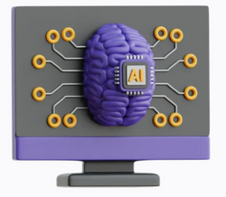
ABOUT THE TRAINING
Internship Organization:
Tata Consultancy Services (TCS), Siruseri, Chennai
Domain:
Healthcare Analytics Machine Learning application in patient data analysis
Project Focus:
Predicting patient hospital stay duration using health-related attributes
Implemented machine learning techniques to build predictive models

Slide 4
ABOUT THE TRAINING
Training Highlights:
Exposure to real-world structured healthcare datasets
Learned data preprocessing, EDA, model training, and evaluation
Applied Python, Pandas, Scikit-learn, and visualization tools
Developed skills in result interpretation and business presentation
Key Takeaways:
Hands-on experience in the full data science lifecycle
Improved problem-solving, data handling, and technical reporting skills
Gained insight into professional workflows followed at TCS

Slide 5




SKILLS LEARNED
Python
Used for data preprocessing, analysis, and machine learning model development.
Pandas
Handled structured data, performed cleaning, transformation, and feature extraction.
NumPy
Performed numerical operations and array-based computations efficiently.
Matplotlib / Seaborn
Created histograms, scatter plots, box plots, and correlation heatmaps for data visualization.

Slide 6
SKILLS LEARNED
Additional & Soft Skills Learned
Understood the fundamentals of Artificial Intelligence and Machine Learning
Gained exposure on Python libraries such as NumPy and Pandas
Improved problem-solving and debugging skills through real-time challenges
Developed effective time management by adhering to project deadlines
Enhanced communication skills through documentation and presentations
Strengthened collaboration and teamwork skills within a professional setup

Slide 7
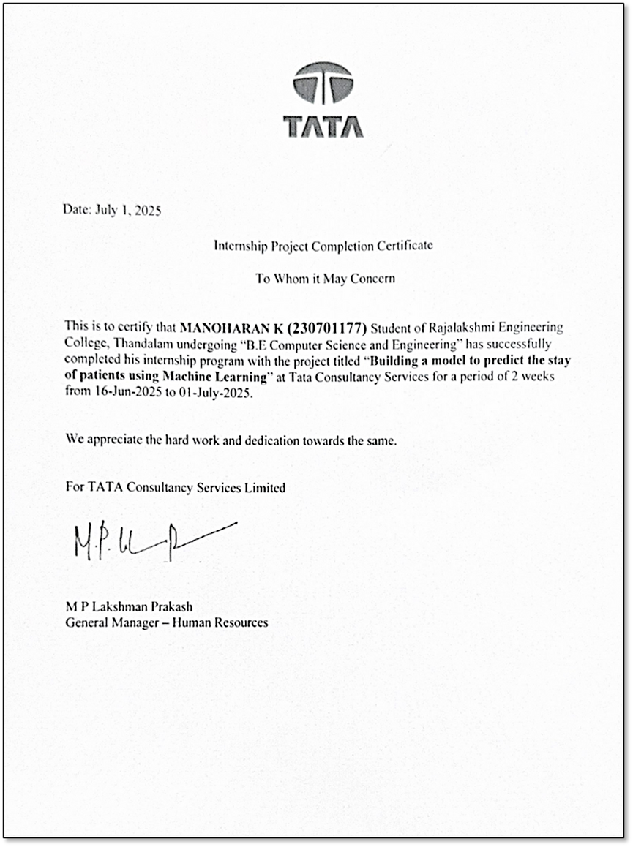
INTERNSHIP CERTIFICATE
Successfully completed a 14-day internship at Tata Consultancy Services (TCS) from 16th June 2025 to 1st July 2025.
The certificate acknowledges the experience in machine learning, data analytics, and real-world problem solving.
It serves as a validation of the technical and professional skills gained during the internship.
The experience and certification adds value to my academic and career journey.

